Slide 1
Light
2024 Quarter 4 Lesson 2

Slide 2
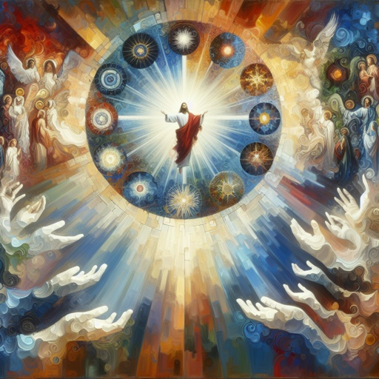
John 1:1-5
1 In the beginning was the Word, and the Word was with God, and the Word was God.

Slide 3
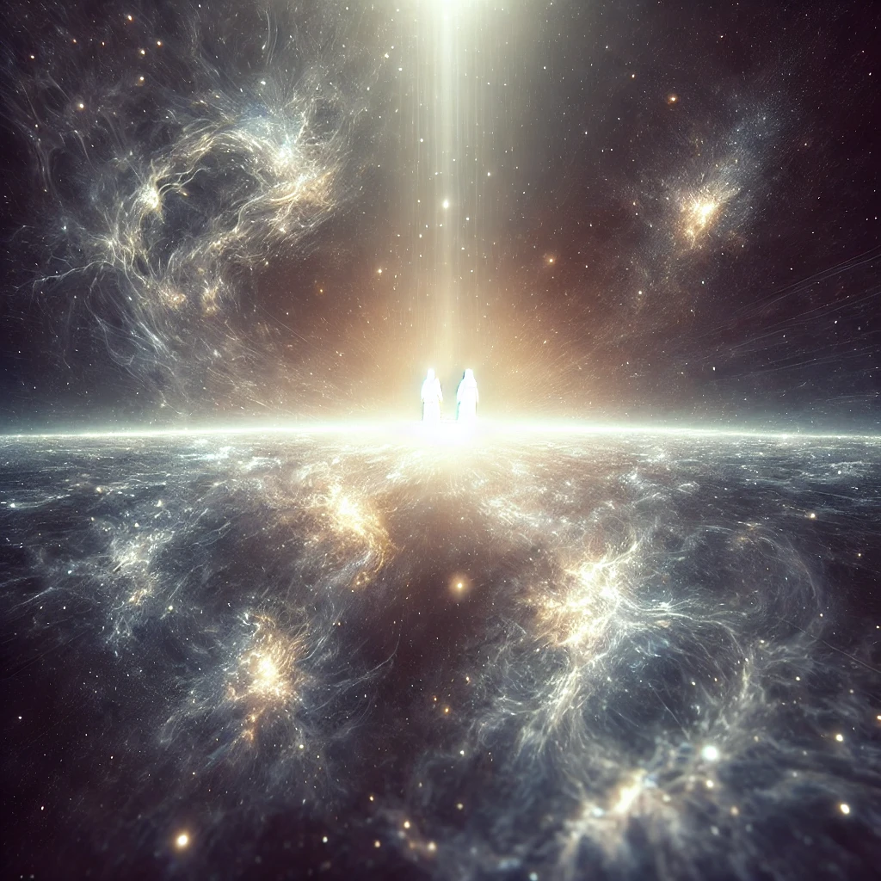
John 1:2-5
2 The same was in the beginning with God.

Slide 4
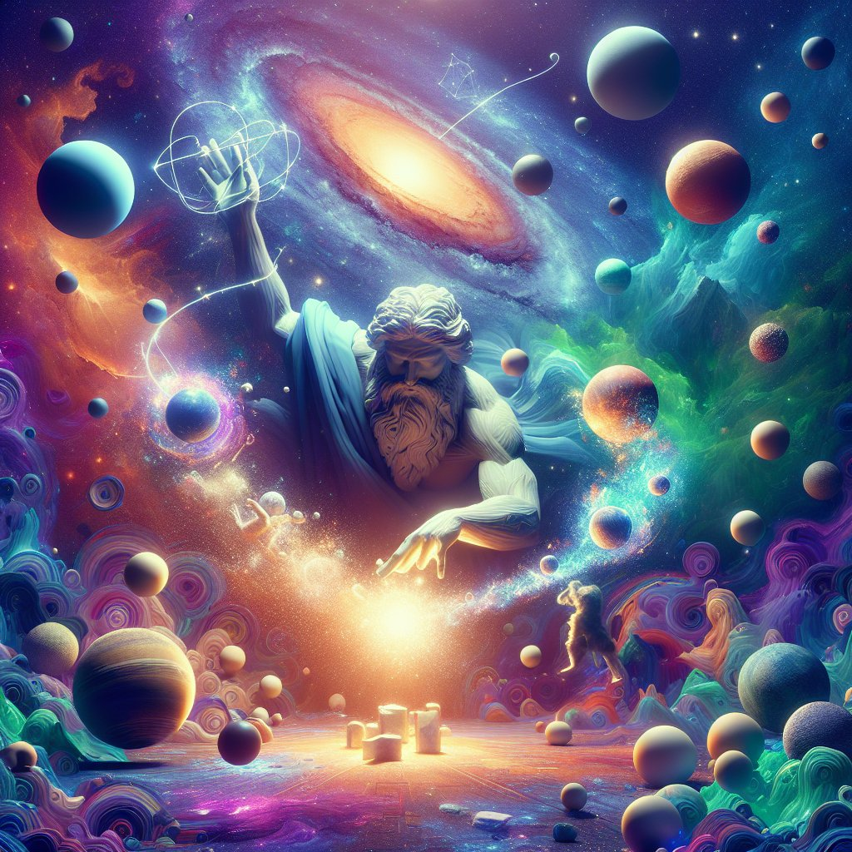
John 1:3-5
3 All things were made by him; and without him was not any thing made that was made.

Slide 5
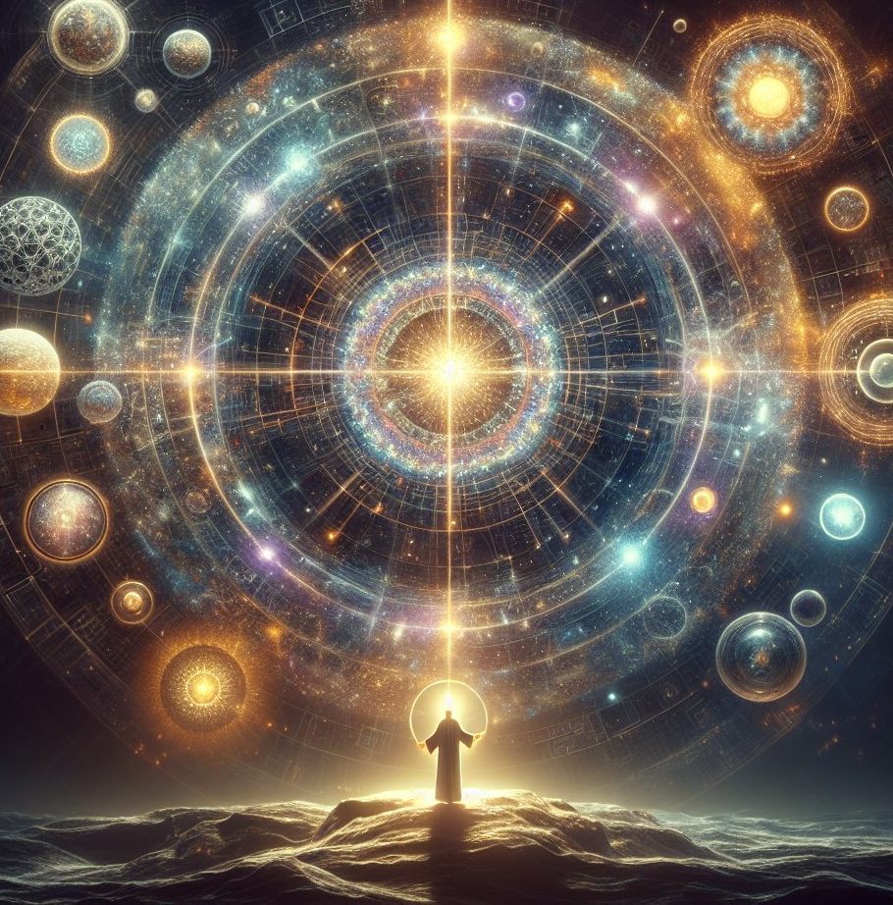
John 1:4-5
4 In him was life; and the life was the light of men.

Slide 6
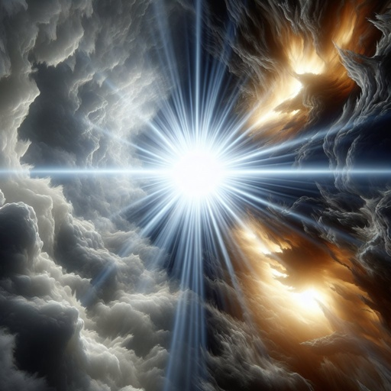
John 1:5
5 And the light shineth in darkness; and the darkness comprehended it not.

Slide 7
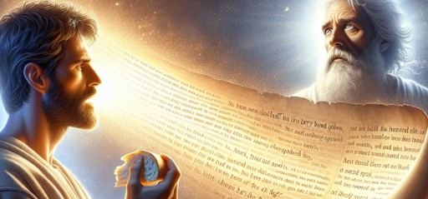
The life of Christ that gives life to the world is in His word. It was by His word that Jesus healed disease and cast out demons; by His word He stilled the sea, and raised the dead; and the people bore witness that His word was with power.
The Desire of Ages, p. 390

Slide 8
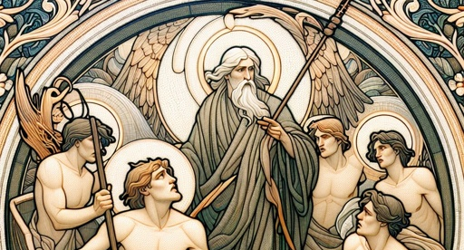
He spoke the word of God, as He had spoken through all the prophets and teachers of the Old Testament. The whole Bible is a manifestation of Christ, and the Saviour desired to fix the faith of His followers on the word.
The Desire of Ages, p. 390

Slide 9
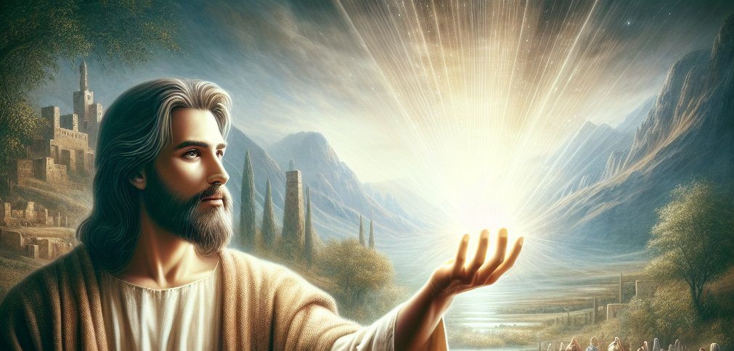
When His visible presence should be withdrawn, the word must be their source of power. Like their Master, they were to live “by every word that proceedeth out of the mouth of God.” Matthew 4:4.
The Desire of Ages, p. 390

Slide 10
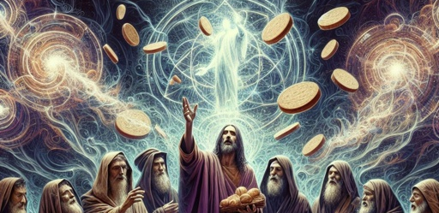
As our physical life is sustained by food, so our spiritual life is sustained by the word of God. And every soul is to receive life from God's word for himself. As we must eat for ourselves in order to receive nourishment, so we must receive the word for ourselves.
The Desire of Ages, p. 390

Slide 11
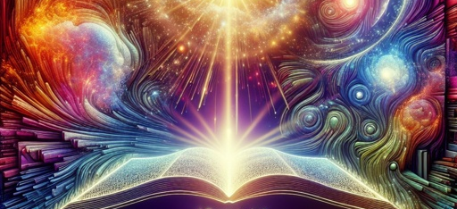
We are not to obtain it merely through the medium of another's mind. We should carefully study the Bible, asking God for the aid of the Holy Spirit, that we may understand His word.
The Desire of Ages, p. 390

Slide 12
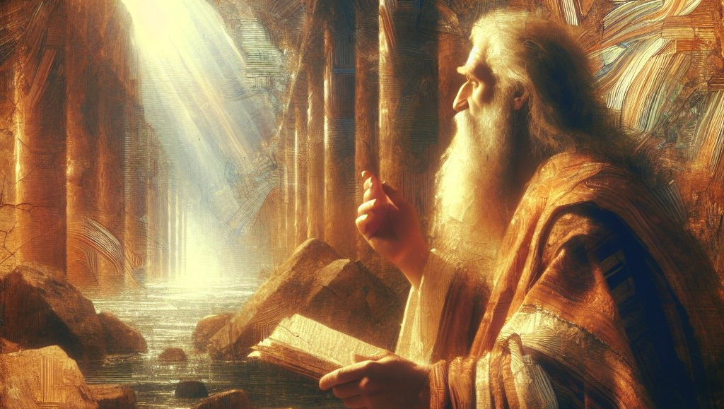
We should take one verse, and concentrate the mind on the task of ascertaining the thought which God has put in that verse for us. We should dwell upon the thought until it becomes our own, and we know “what saith the Lord.”
The Desire of Ages, p. 390

Slide 13
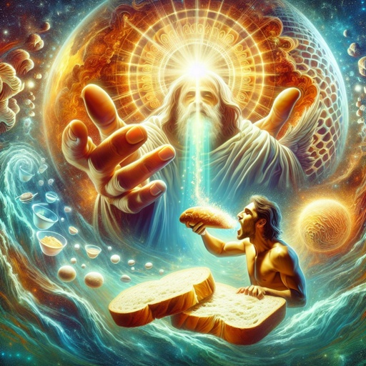
John 6:51
51 I am the living bread which came down from heaven: if any man eat of this bread, he shall live for ever: and the bread that I will give is my flesh, which I will give for the life of the world.

Slide 14
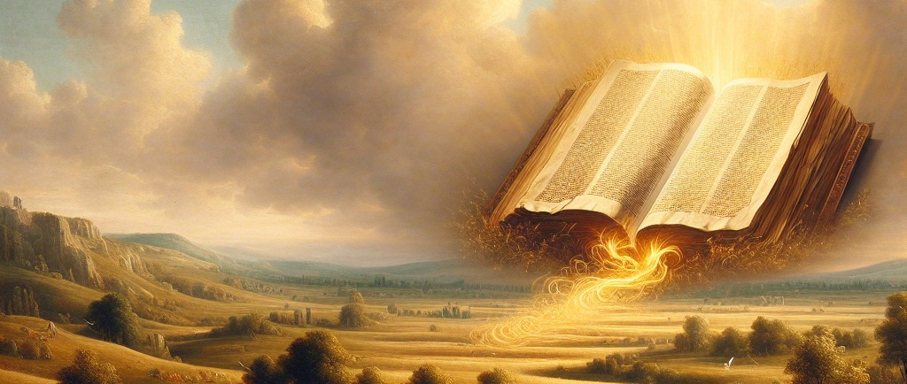
By looking constantly to Jesus with the eye of faith, we shall be strengthened. God will make the most precious revelations to His hungering, thirsting people. They will find that Christ is a personal Saviour. As they feed upon His word, they find that it is spirit and life.
The Desire of Ages, p. 391

Slide 15
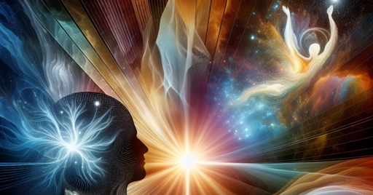
The word destroys the natural, earthly nature, and imparts a new life in Christ Jesus. The Holy Spirit comes to the soul as a Comforter. By the transforming agency of His grace, the image of God is reproduced in the disciple; he becomes a new creature.
The Desire of Ages, p. 391

Slide 16
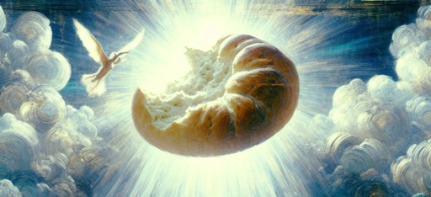
Love takes the place of hatred, and the heart receives the divine similitude. This is what it means to live “by every word that proceedeth out of the mouth of God.” This is eating the Bread that comes down from heaven.
The Desire of Ages, p. 391

Slide 17
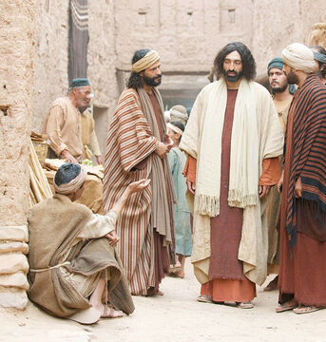
John 9:1-41
9 And as Jesus passed by, he saw a man which was blind from his birth.
2 And his disciples asked him, saying, Master, who did sin, this man, or his parents, that he was born blind?

Slide 18
The Desire of ages p. 471
It was generally believed by the Jews that sin is punished in this life. Every affliction was regarded as the penalty of some wrongdoing, either of the sufferer himself or of his parents.

Slide 19
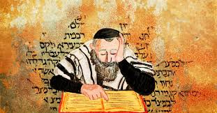
Talmud, Shabbat 55a, Soncino ed., p. 255
"There is no death without sin, and there is no suffering without iniquity."

Slide 20
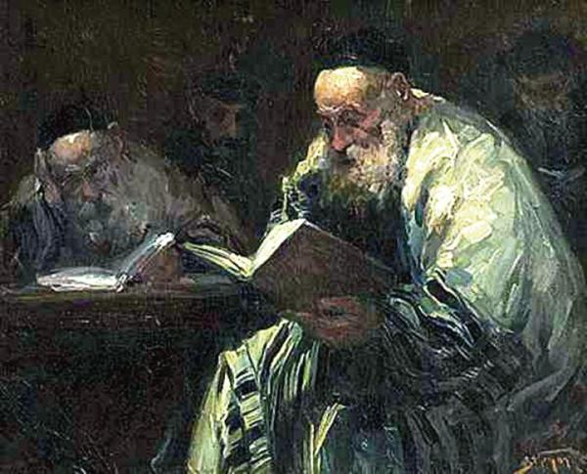
Talmud, Nedarim 41a, Soncino ed., p. 130
"A sick man does not recover from his sickness until all his sins are forgiven him."

Slide 21
The rabbis further taught that God was careful that sin meets its punishment according to the rule, measure for measure. Several examples of the rule are given in the Mishna:

Slide 22
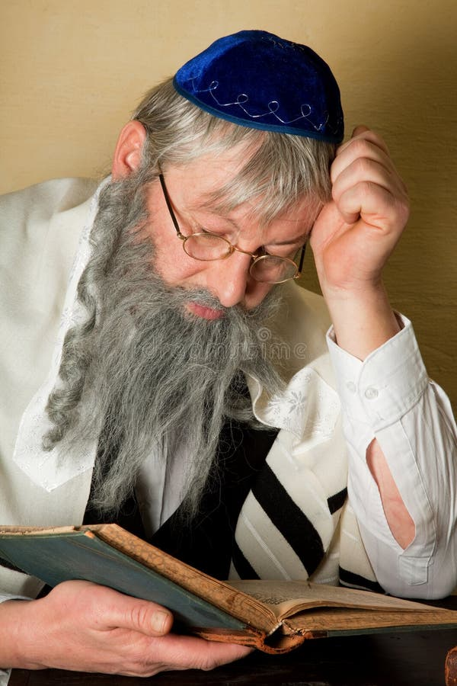
Sotah 1.7,8, Soncino ed. of the Talmud, pp. 37, 41
"Samson went after [the desire of] his eyes; therefore, the Philistines put out his eyes . . .
Absalom gloried in his hair; therefore, he was hanged by his hair.”

Slide 23
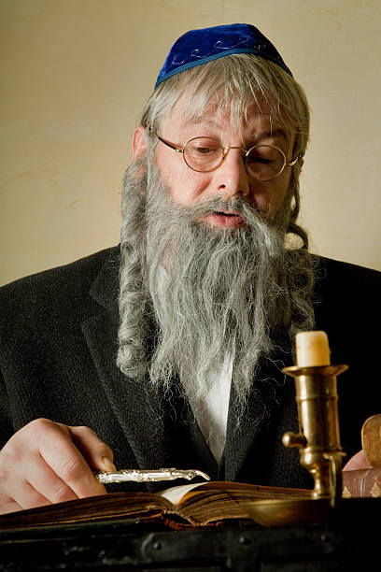
Sotah 1.7,8, Soncino ed. of the Talmud, pp. 37, 41
“And because he cohabited with the ten concubines of his father, therefore he was stabbed with ten lances…”

Slide 24
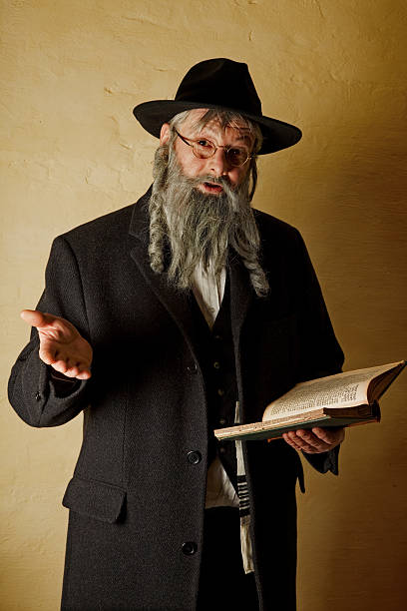
Sotah 1.7,8, Soncino ed. of the Talmud, pp. 37, 41
And because he stole three hearts, the heart of his father, the heart of the court of justice, and the heart of Israel, . . . therefore three darts were thrust through him."

Slide 25
The Jews held that every sin had its peculiar punishment, and believed it possible in certain cases, at least, to determine the guilt of a man by the nature of his suffering. After the destruction of the Temple and the end of the Sanhedrin, and with it the end of Jewish executions, Rabbi Joseph taught that God visited natural calamities upon those deserving death:

Slide 26
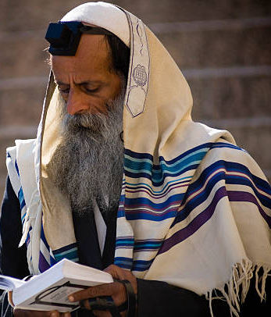
Talmud Kethuboth 30a, 30b, Soncino ed., p.167
“One who was liable to be executed by stoning either falls from the roof or a beast tramples him…”
“And one who was liable to be executed by burning either falls into a conflagration or a snake bites him, which creates a burning sensation.”

Slide 27
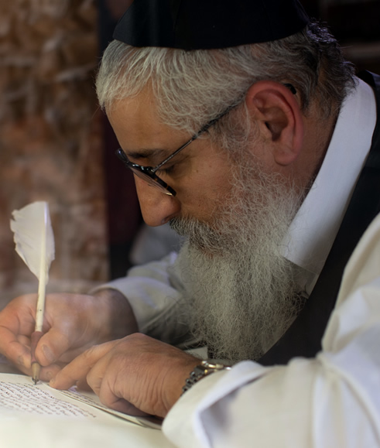
Talmud Kethuboth 30a, 30b, Soncino ed., p.167
“And one who was liable to be executed by decapitation is either handed over to the ruling monarchy for execution by sword, or bandits attack and kill him.”
“And one who was liable to be executed by strangulation either drowns in a river, or dies of diphtheria…”

Slide 28
The Desire of ages p. 471
It is true that all suffering results from the transgression of God's law, but this truth had become perverted. Satan, the author of sin and all its results, had led men to look upon disease and death as proceeding from God,—as punishment arbitrarily inflicted on account of sin.

Slide 29
The Desire of ages p. 471
Hence one upon whom some great affliction or calamity had fallen had the additional burden of being regarded as a great sinner.
Thus the way was prepared for the Jews to reject Jesus. He who “hath borne our griefs, and carried our sorrows” was looked upon by the Jews as “stricken, smitten of God, and afflicted;” and they hid their faces from Him. Isaiah 53:4, 3

Slide 30
The Desire of ages p. 471
God had given a lesson designed to prevent this. The history of Job had shown that suffering is inflicted by Satan, and is overruled by God for purposes of mercy. But Israel did not understand the lesson. The same error for which God had reproved the friends of Job was repeated by the Jews in their rejection of Christ.

Slide 31
The Desire of ages p. 471
The belief of the Jews in regard to the relation of sin and suffering was held by Christ's disciples. While Jesus corrected their error, He did not explain the cause of the man's affliction, but told them what would be the result. Because of it the works of God would be made manifest.

Slide 32
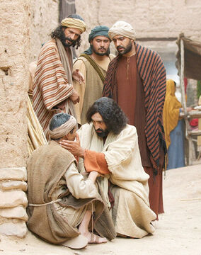
John 9:3-41
3 Jesus answered, Neither hath this man sinned, nor his parents: but that the works of God should be made manifest in him.

Slide 33
For those that love Him,
God works all things, including afflictions sent by the enemy, for good (Rom. 8:28). In the providence of God, the inflictions of the enemy are overruled for our good.

Slide 34
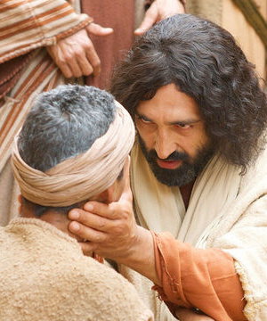
John 9:4-41
4 I must work the works of him that sent me, while it is day: the night cometh, when no man can work.
5 As long as I am in the world, I am the light of the world.

Slide 35
The phrase “while it is day” suggests urgency. For Jesus the night was not far away. His brief ‘day’ was the time of His ministry here on earth; the arrival of His night, the time when He would depart out of this world.

Slide 36
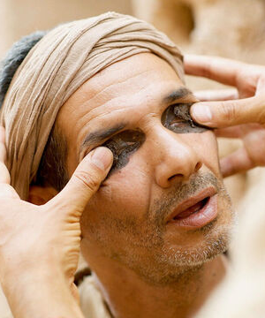
John 9:6-41
6 When he had thus spoken, he spat on the ground, and made clay of the spittle, and he anointed the eyes of the blind man with the clay,

Slide 37
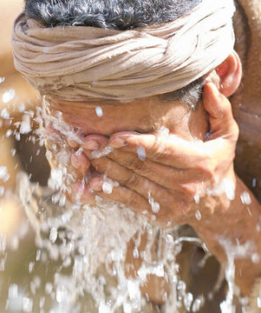
John 9:7-41
7 And said unto him, Go, wash in the pool of Siloam, (which is by interpretation, Sent.) He went his way therefore, and washed, and came seeing.

Slide 38
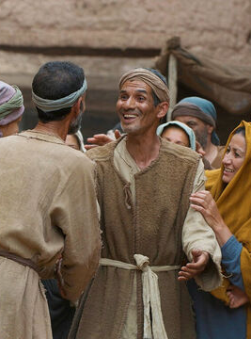
John 9:8-41
8 The neighbours therefore, and they which before had seen him that he was blind, said, Is not this he that sat and begged?
9 Some said, This is he: others said, He is like him: but he said, I am he.

Slide 39
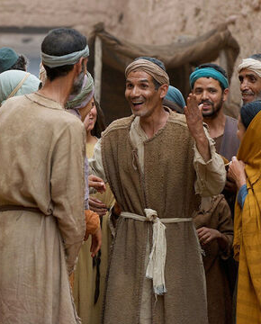
John 9:10-41
10 Therefore said they unto him, How were thine eyes opened?
11 He answered and said, A man that is called Jesus made clay, and anointed mine eyes, and said unto me, Go to the pool of Siloam, and wash: and I went and washed, and I received sight.

Slide 40
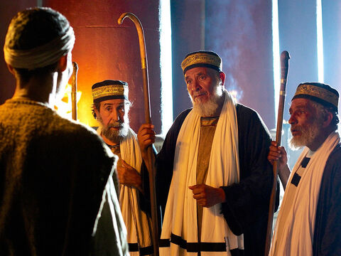
John 9:12-41
12 Then said they unto him, Where is he? He said, I know not.
13 They brought to the Pharisees him that aforetime was blind.
14 And it was the sabbath day when Jesus made the clay, and opened his eyes.

Slide 41
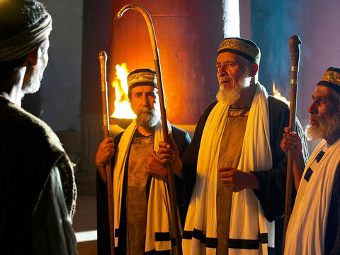
John 9:15-41
15 Then again the Pharisees also asked him how he had received his sight. He said unto them, He put clay upon mine eyes, and I washed, and do see.

Slide 42
John 9:16-41
16 Therefore said some of the Pharisees, This man is not of God, because he keepeth not the sabbath day. Others said, How can a man that is a sinner do such miracles? And there was a division among them.

Slide 43
The Desire of ages p. 472
The Pharisees hoped to make Jesus out to be a sinner, and therefore not the Messiah. They knew not that it was He who had made the Sabbath and knew all its obligation, who had healed the blind man. They appeared wonderfully zealous for the observance of the Sabbath, yet were planning murder on that very day. But many were greatly moved at hearing of this miracle, and were convicted that He who had opened the eyes of the blind was more than a common man. In answer to the charge that Jesus was a sinner because He kept not the Sabbath day, they said, “How can a man that is a sinner do such miracles?”

Slide 44
John 9:17-41
17 They say unto the blind man again, What sayest thou of him, that he hath opened thine eyes? He said, He is a prophet.

Slide 45
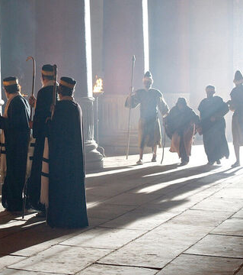
John 9:18-41
18 But the Jews did not believe concerning him, that he had been blind, and received his sight, until they called the parents of him that had received his sight.

Slide 46
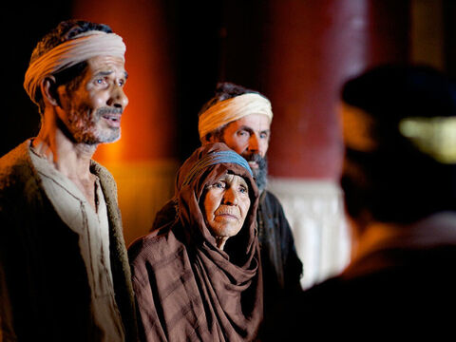
John 9:19-41
19 And they asked them, saying, Is this your son, who ye say was born blind? how then doth he now see?
20 His parents answered them and said, We know that this is our son, and that he was born blind:

Slide 47
John 9:21-41
21 But by what means he now seeth, we know not; or who hath opened his eyes, we know not: he is of age; ask him: he shall speak for himself.

Slide 48
John 9:22-41
22 These words spake his parents, because they feared the Jews: for the Jews had agreed already, that if any man did confess that he was Christ, he should be put out of the synagogue.
23 Therefore said his parents, He is of age; ask him.

Slide 49
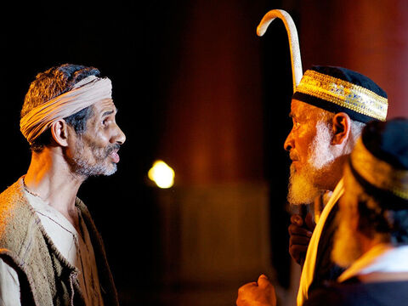
John 9:24-41
24 Then again called they the man that was blind, and said unto him, Give God the praise: we know that this man is a sinner.
25 He answered and said, Whether he be a sinner or no, I know not: one thing I know, that, whereas I was blind, now I see.

Slide 50
The Desire of ages p. 474
The Pharisees did not realize that they had to deal with any other than the uneducated man who had been born blind; they knew not Him with whom they were in controversy. Divine light shone into the chambers of the blind man's soul. As these hypocrites tried to make him disbelieve, God helped him to show, by the vigor and pointedness of his replies, that he was not to be ensnared.

Slide 51
John 9:26-41
26 Then said they to him again, What did he to thee? how opened he thine eyes?
27 He answered them, I have told you already, and ye did not hear: wherefore would ye hear it again? will ye also be his disciples?

Slide 52
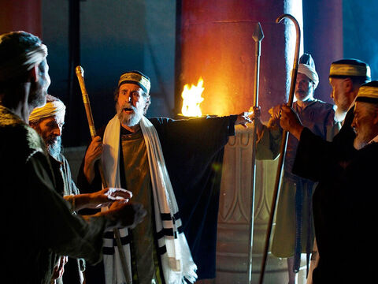
John 9:28-41
28 Then they reviled him, and said, Thou art his disciple; but we are Moses' disciples.
29 We know that God spake unto Moses: as for this fellow, we know not from whence he is.

Slide 53
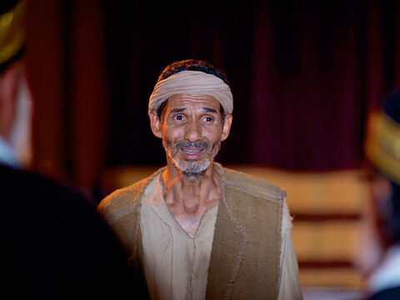
John 9:30-41
30 The man answered and said unto them, Why herein is a marvellous thing, that ye know not from whence he is, and yet he hath opened mine eyes.

Slide 54
The Desire of ages p. 474
The Lord Jesus knew the ordeal through which the man was passing, and He gave him grace and utterance, so that he became a witness for Christ. He answered the Pharisees in words that were a cutting rebuke to his questioners. They claimed to be the expositors of Scripture, the religious guides of the nation; and yet here was One performing miracles, and they were confessedly ignorant as to the source of His power, and as to His character and claims.

Slide 55
John 9:31-41
31 Now we know that God heareth not sinners: but if any man be a worshipper of God, and doeth his will, him he heareth.
32 Since the world began was it not heard that any man opened the eyes of one that was born blind.
33 If this man were not of God, he could do nothing.

Slide 56
John 9:34-41
34 They answered and said unto him, Thou wast altogether born in sins, and dost thou teach us? And they cast him out.

Slide 57
The Desire of ages p. 474
The man had met his inquisitors on their own ground. His reasoning was unanswerable. The Pharisees were astonished, and they held their peace,—spellbound before his pointed, determined words. For a few moments there was silence. Then the frowning priests and rabbis gathered about them their robes, as though they feared contamination from contact with him; they shook off the dust from their feet, and hurled denunciations against him,—“Thou wast altogether born in sins, and dost thou teach us?” And they excommunicated him.

Slide 58
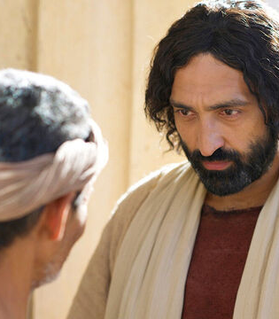
John 9:35-41
35 Jesus heard that they had cast him out; and when he had found him, he said unto him, Dost thou believe on the Son of God?
36 He answered and said, Who is he, Lord, that I might believe on him?

Slide 59
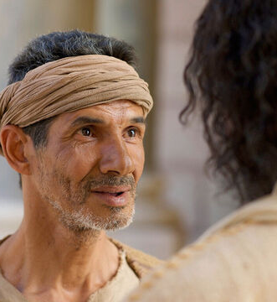
John 9:37-41
37 And Jesus said unto him, Thou hast both seen him, and it is he that talketh with thee.
38 And he said, Lord, I believe. And he worshipped him.

Slide 60
The Desire of ages p. 475
The man cast himself at the Saviour's feet in worship. Not only had his natural sight been restored, but the eyes of his understanding had been opened. Christ had been revealed to his soul, and he received Him as the Sent of God.

Slide 61
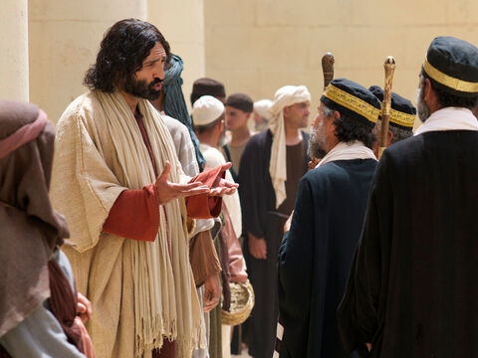
John 9:39-41
39 And Jesus said, For judgment I am come into this world, that they which see not might see; and that they which see might be made blind.

Slide 62
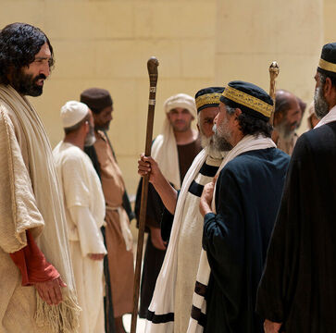
John 9:40-41
40 And some of the Pharisees which were with him heard these words, and said unto him, Are we blind also?

Slide 63
The Desire of ages p. 475
The manifestation of divine power that had given to the blind man both natural and spiritual sight had left the Pharisees in yet deeper darkness. Some of His hearers, feeling that Christ's words applied to them, inquired, “Are we blind also?” Jesus answered, “If ye were blind, ye should have no sin.” If God had made it impossible for you to see the truth, your ignorance would involve no guilt.

Slide 64
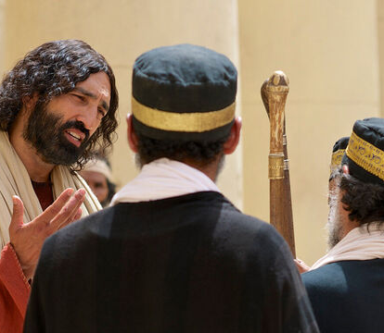
John 9:41
41 Jesus said unto them, If ye were blind, ye should have no sin: but now ye say, We see; therefore your sin remaineth.

Slide 65
The Desire of ages p. 475
“But now ye say, We see.” You believe yourselves able to see, and reject the means through which alone you could receive sight. To all who realized their need, Christ came with infinite help. But the Pharisees would confess no need; they refused to come to Christ, and hence they were left in blindness,—a blindness for which they were themselves guilty. Jesus said, “Your sin remaineth.”

Slide 66
The end
Happy Sabbath!

